Slide 1
Knowledge gaps in formulating TB Control Policies for Prisons
22nd International AIDS Conference,
Amsterdam 24 July 2018
Dr Masoud Dara
Coordinator, Communicable Diseases
WHO Regional Office for Europe

Slide 2
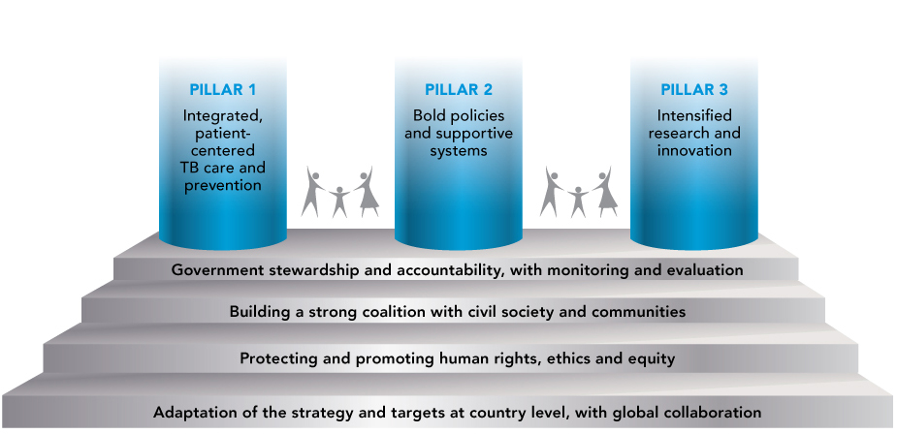
End TB Strategy: vision, goal, targets, principles
Vision
Zero TB deaths, Zero TB disease, and Zero TB suffering (a world free of TB)
Goal
End the Global TB epidemic
 | Milestones |  | Targets
 | 2020 | 2025 | 2030 (SDG) | 2035 (end TB)
Reduction of TB deaths (2015 baseline) | 35% | 75% | 90% | 95%
Reduction of TB incidence (2015 baseline) | 20% | 50% | 80% | 90%
TB families with catastrophic costs due to TB | 0% | 0% | 0% | 0%

Slide 3
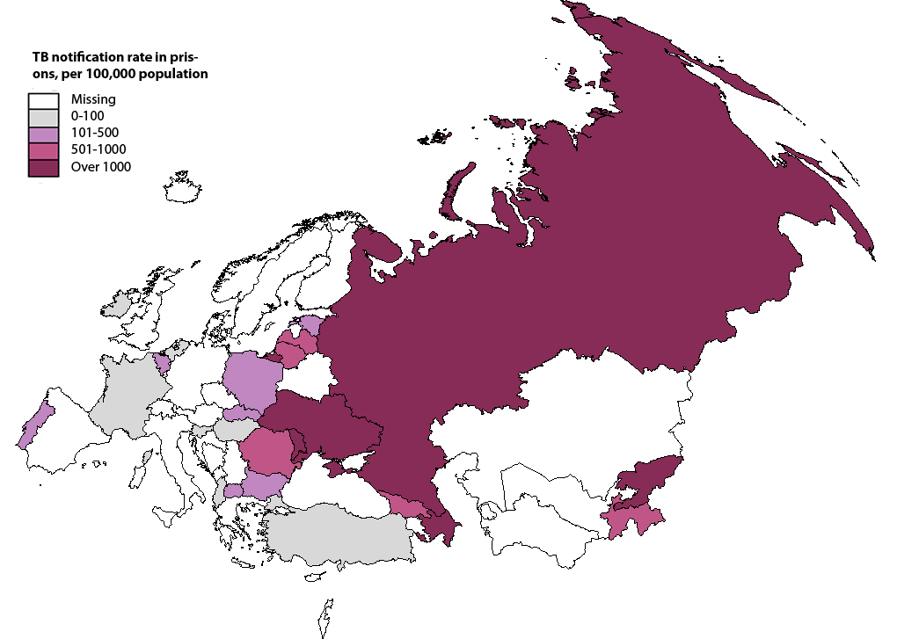
TB notification in prisons
About 1 of 16 TB cases notified in the European region was prisoner (6%)
TB notification rate in prisons in European region is 26 times higher (862/100k vs 32,8/100k)
In Thailand, Ethiopia, India and Brazil, TB rates were reported to be almost 8, 7, 23 and 64-times higher, respectively
TB in prisons is more likely to be drug-resistant or associated with HIV coinfection
Up to 70% loss to treatment follow-up after release from prison
Implementation of rapid diagnostics and new anti-TB medicines is far behind the civil population
ECDC /WHO Regional Office for Europe. Tuberculosis surveillance and monitoring in Europe 2018 – 2016 data.
Good practices in the prevention and care of tuberculosis and drugresistant tuberculosis in correctional facilities. WHO. 2018
Notes:
Заболеваемость ТБ в тюрьмах выше, чем среди общего населения
Глобально – до 64 раз

Slide 4
TB treatment outcomes in prisons
Favourable treatment outcome among new and relapse TB cases In prisons versus civilan sector in WHO European Region (2014 cohort)
59,9% vs.78,5%
.

Slide 5
Challenges in prisons
Early diagnosis | Limited laboratory capacity Lack of well-organized TB screening
Quality treatment | Poor supply of medicines Possible lack of interest to be cured, prisoners’ hierarchy High prisoners’ turnover Poor referral to civilian system, continuum of care Higher drug resistance rate
Comorbidities/coinfections | High rate of drug use, HIV, viral hepatitis
Political commitment | Limited resources Close coordination with Ministry of Health/integration
Limited partnership | Limited collaboration with NGOs

Slide 6
IUATLD TB Control in Prisons Working Group
Conducted a global consultation and review of evidence resulted with an official Union statement outlining key recommendations for preventing risk and providing care
Members of this group contribute to building evidence for policy change on TB control in prisons

Slide 7
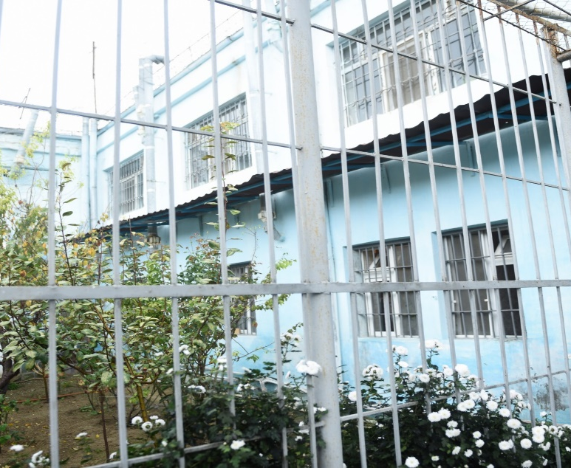
Key knowledge gaps
When people get TB
The best mechanism for continuum of care
Which screening method to use
How to improve adherence
Which other comorbidities one needs to consider
What are the factor influencing better outcome and impact
How to ensure full commitment for TB and TB/HIV in prison

Slide 8
Compendium of Good Practices on TB in prisons
Compendium of Good practices released in 2018 is designed to share and disseminate the knowledge gained in the management of TB in penitentiary systems globally and to promote more effective implementation of the End TB Strategy around the globe
Scaling up good practices is crucial in achieving the ultimate goal of ending the TB epidemic.
http://www.euro.who.int/__data/assets/pdf_file/0003/360543/TB-prisons-9789289052917-eng.PDF?ua=1

Slide 9
WHO Collaboration on prevention and control of TB in prisons, Baku, Azerbaijan
Since 1995 implementation of WHO recommendations
Systematic TB case finding
Rapid diagnostics
Effective treatment including with new and repurposed anti-TB medicines
WHO CC on prevention and control of TB in prisons since 2014
International training, study-tours and workshops for more than 200 participants all over the world
http://www.euro.who.int/en/health-topics/communicable-diseases/tuberculosis/partners-and-networks/who-collaborating-centre-in-azerbaijan-on-tuberculosis-in-prisons

Slide 11
High-level spotlight on ending TB
2017
2018
26 September 2018
Notes:
A year of commitments and action to end TB

Slide 12
Thank you very much for your attention
Contact:
eurohiv@who.int www.euro.who.int/aids

Slide 13
Acknowledgements
Dr Ogtay Gozalov, Medical officer at Joint Tuberculosis, HIV and viral Hepatitis Programme, WHO Regional Office for Europe
Dr Elmira Gurbanova, Head of WHO CC on TB prevention and control in prisons in Baku

